Slide 1
Introduction to VFR Charts

Slide 2
What is a VFR Chart
It is an aerial map of the ground that shows important information to pilots flying overhead
This information includes the airspace of the location and its boundaries
Airport type and contact frequency information
Topographical landmarks and elevation

Slide 3
Key features

Slide 4
Water Features
Light blue coloring refers to ‘Open Water’ such as bays, oceans, large lakes, and the water sources that feed them
‘Inland Water’ is denoted by dark blue and represents lakes, rivers, and reservoirs

Slide 5
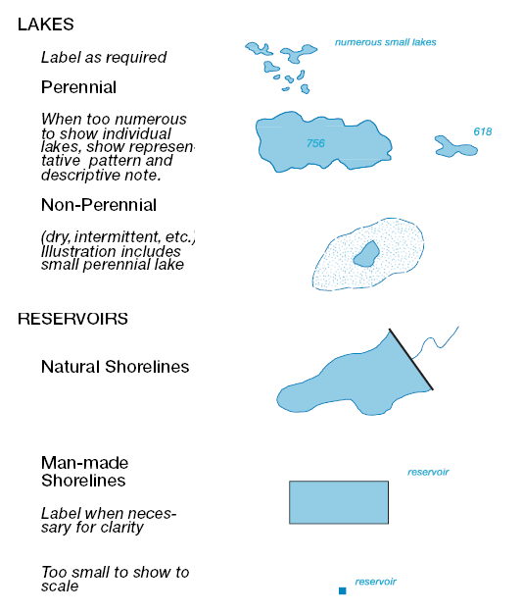
Water Features
Perennial lake are a constant size year round while non-perennial lakes fluctuate in size
Man made shorelines are straight lines and may be labeled
Reservoirs that are too small to depict will be labeled by a point

Slide 6
Elevation
Elevation is read using a color coded legend that is specific to the map being read
Elevation is measured in relation to sea-level and may be negative at certain locations

Slide 7
Elevation
Special markers denote other obstacles with their height MSL and AGL
AGL will be in parentheses and may be excluded in congested maps to avoid confusion

Slide 8
NAVAID

Slide 9
NAVAID
NAVAIDs help pilots with understand the direction to fly
There are several different types and may be combined on VFR charts

Slide 10
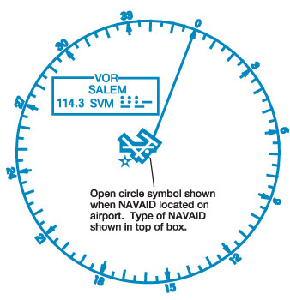
NAVAID
At airports NAVAIDs will be identified by an open circle next to the runway
The type of NAVAID will be displayed at the top of the box with the rest of the airstrip information

Slide 11
Airports

Slide 12
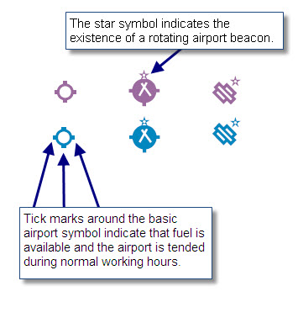
Airports
The color of the airfield determines whether it is towered (blue) or un-towered (purple)
Tick marks indicate that services are provided
A star denotes a beacon at the airport

Slide 13
Airports
The image displayed can illustrate whether a runway is paved and how long it extends
The lines represent the runways and vary for every airport

Slide 14
Airports
Special types of airports include military bases, private airports, and helipads
Abandoned airports are also shown so as to not confuse pilots

Slide 15
Airports
Airports also have an identifying box that gives useful information to pilots
This includes the name, radio frequency, altitude, the type of NAVAID, and weather information

Slide 16
Airports
In the top left part of the airport identification box the 122.1R represents the frequency that is only receiving because of the ‘R’
To receive a message back the frequency has to be changed to 123.6

Slide 17
Airport
The VORTAC circled in red means that the airports NAVAID is a combination of VOR and TACAN
In the black circle is the weather information that is available from the airport

Slide 18
Airspace

Slide 19
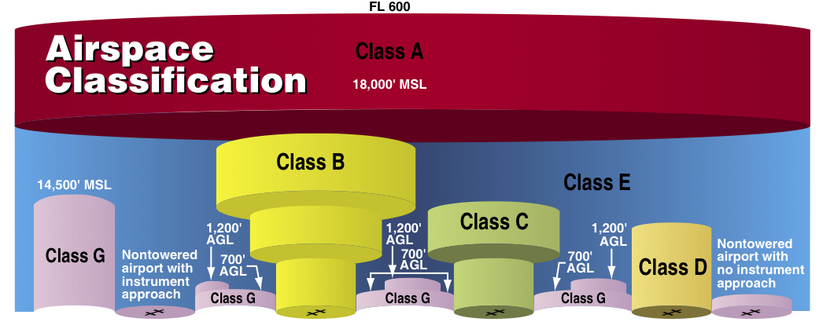
Airspace
Airspace classifications are dependent on altitude and neighboring airspaces
The airspace between defined spaces is class E airspace

Slide 20
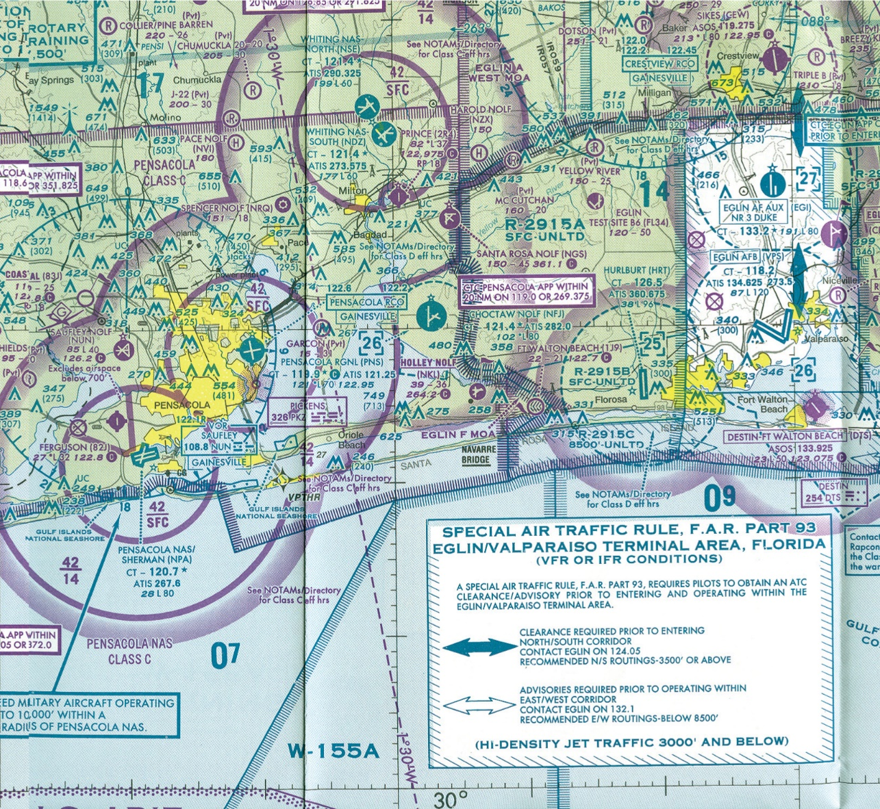
Airspace
Airports have a ring(s) around them designating the type of airspace around them
This may be different to the surrounding airspace outside of the ring at the same altitude

Slide 21
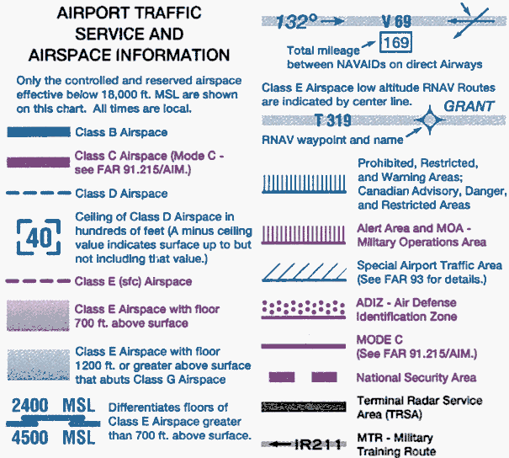
Airspace
The type of airspace defined by the ring is determined both by color and style
These markings can also denote military or restricted airspace around certain areas

Slide 22
Airspace
Airspace is also different when flying over densely populated areas such as cities
These areas are shown in yellow on the VFR charts and may have distinct airspaces

Slide 23
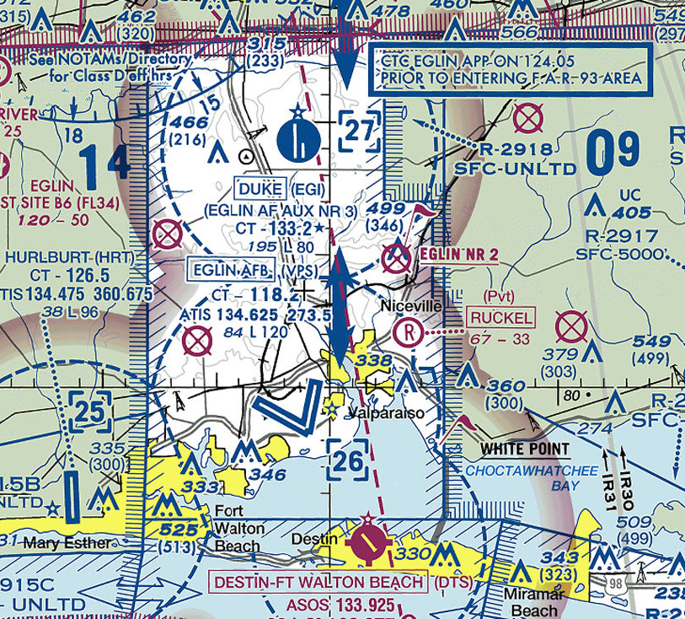
Airspace
Some airspace may have a different set of rules concerning navigation through it
This spaces is shown in white to define the area with special air traffic rules

Slide 24
Airspace
The ceiling and floor of an airspace correspond to the top and bottom numbers in the picture respectively
There may not be numbers, but other designations, such as ‘surface level’ or to another airspace value

